Slide 1

The Scrum-agile approach
This Photo by Unknown Author is licensed under CC BY-NC
By
Christopher Harvestine

Slide 2

Meet The Scrum Team

Slide 3

The Product Owner
Defines User Stories
Manages The Team Backlog
Prioritizes The Team Backlog To Streamline Development
Anticipates Client Needs
Evaluates Product Progress Continually
This Photo by Unknown Author is licensed under CC BY-NC

Slide 4

The Scrum Master
A Servant Leader That Removes Roadblocks To Progress.
Protects Teams By Empowering Them
Works With Leadership To Get Tools And Training For The Team
Creates Scrum Ceremonies To Ensure The Team Is On Track
Champions Information Radiators For Teams And Stakeholders

Slide 5

The Developer
Achieves Goals Defined For Each Sprint
Identifies Issues With Development And Reports To the Scrum Master
Attend Daily Scrum Meetings And Report Completed Tasks.
Communicates And Collaborates With Other Team Members
This Photo by Unknown Author is licensed under CC BY

Slide 6

The Product Tester
Makes Comparisons Between The Product Backlog And The Product
Identify Bugs And Exception Handling In The Code
Attends Sprint Retrospectives
Tests Code Throughout The Current Sprint
Works Closely With Developers

Slide 7


What is Scrum-Agile?
A process in which teams can manage a project by breaking it up in several stages.
It starts with the customer’s expectations of how they want the product to be
It involves constant collaboration between team members and stake holders to make informed decisions
It is dynamic and able to change directions to fit the customer’s needs
This Photo by Unknown Author is licensed under CC BY-SA

Slide 8

Why Is Agile So Popular?
1-4 Week sprints create a sense of urgency and creates increased productivity
Products completed early gives the stakeholder a chance for feedback
It holds productive and effective meetings which allows the developers a chance to get the resources they need in order to complete their sprint
Encourages a low level of management which negates things like micromanaging
This Photo by Unknown Author is licensed under CC BY

Slide 9
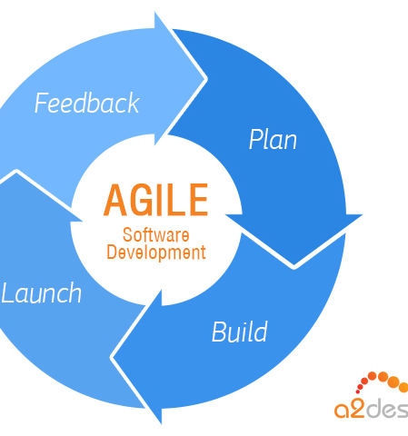
What are the Stages Of Agile Development
Projects are envisioned and prioritized
Diagram requirements for the initial sprint
Construction of the product with iteration
Test quality of product continually and document results
Deliver product to stakeholders and customers
Solicit feedback from the customer and stakeholders and
gather information to incorporate into the next sprint.
This Photo by Unknown Author is licensed under CC BY-SA

Slide 10

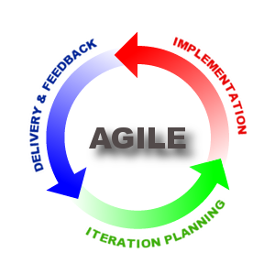
The Differences Of Waterfall And Agile
Waterfall
Software development process is divided into distinct phases.
Waterfall methodology is a sequential design process.
Software development will be completed as one single project.
There way of changing the requirements once the project development starts
Agile
It separates the project development lifecycle into sprints
It follows an incremental approach, small achievable goals.
A methodology that is known for its flexibility.
A methodology where testing is performed concurrently with software development.
Introduces a mindset where the software product satisfies needs of its end customers and changes itself upon customer feedback.
This Photo by Unknown Author is licensed under CC BY
This Photo by Unknown Author is licensed under CC BY-SA

Slide 11

The Advantages Of An Agile Approach
It is focused client process. So, it makes sure that the user is continuously involved during every stage.
Agile teams are extremely motivated and self-organized this provides better results from the development projects.
The agile software development method assures that quality of the development is maintained at all stages from inception to final product.
The process is based on an incremental progress. The client and team know exactly what needs to be completed. This reduces risk in the development process.
This Photo by Unknown Author is licensed under CC BY-SA-NC

